Slide 1
Welcome to
Our Sunday School
We’ll start at 9:07
visit OurSundaySchool.com for more about our class

Slide 2
Today’s class (pages 45-48)
Philippians 1:10d-11

Slide 3
Philippians 1:9-11 (CSB)
And I pray this: that your love will keep on growing in knowledge and every kind of discernment, so that you may approve the things that are superior and may be pure and blameless in the day of Christ, filled with the fruit of righteousness that comes through Jesus Christ to the glory and praise of God.

Slide 4
Today’s class (pages 45-48)
Philippians 1:10d-11

Slide 5
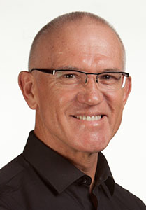
Dr. Mark Keown This is another example of the language of living by the Spirit, though without direct recourse to pneuma.

Slide 6
Today’s class (pages 45-48)
Philippians 1:10d-11

Slide 7
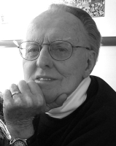
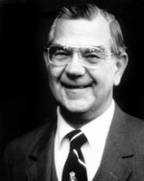
Dr. G. F. Hawthorne & Dr. Ralph P. Martin In exactly the same way that the life of Jesus and its influence on humankind were ordained for the glory of the Father…

Slide 8
Dr. G. F. Hawthorne & Dr. Ralph P. Martin … so the life of the Philippian community and its influence on its environs are also ordained for the glory and praise of God.

Slide 9
Dr. G. F. Hawthorne & Dr. Ralph P. Martin Paul can see it no other way: as the master was, so must the servant be.

Slide 10
Today’s class (pages 45-48)
Philippians 1:10d-11

Slide 11
Dr. Mark Keown This is the language of worship in its broadest sense—whole lives of righteous serving that bring glory and praise to God by enhancing his reputation and fame before humanity

Slide 12
Today’s class (pages 45-48)
Philippians 1:10d-11

Slide 13
Dr. Mark Keown The passage is rooted in the present, remembering the past, but with an eye to the future hope of redemption at the day of Christ.

Slide 14
Prayer Time
Write down your prayer requests (on the Weekly Update or in the comments)
Lean in, engage, and pray for someone not with you
Go worship

